Slide 1
DOCKER SECURITY
By
VIVEK VIJAY SARKALE

Slide 2
Overview
What is Docker or Container Based Virtualization ? - App 5 min
* Quick intro to Docker Basic Building Blocks & Docker
Architecture .( LXC ,Image, Docker Engine & Hub ,NS,Cgroups)
* VM vs LXC ( Based on Application deployment )
Analysis on Docker Security. App 5min
* Loopholes
* Security Threats
Existing Docker Security System and Models App 15 min
* Container Security or Internal Security features
*Namespace- PID , MOUNT , NET , IPC , UTS
*Cgroups
* Linux Capabilities
* Other Security Model
* SElinux
*AppArmor
*SECComp
Proposed Security Model in Docker Environment App 15 min
* Model 1 -VMM + LXC
*Model 2- Root Remapping
*Model 3-Security Layer Using Own Access control Mechanism
*Model 4-Hybrid Model

Slide 3
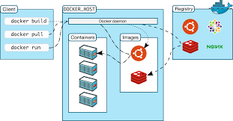
Dockers or Container Based Virtualization
Docker provide us container based virtualization , It is a Open Platform to build ,ship and run distributed application .
Docker Basic Building blocks

Slide 4
LXC – Linux Containers , Namespace & Cgroups.
LXC:
In Linux Containers are OS level virtualization environment which is used by docker to wrap different s/w with all its dependencies.
Very Flexible , Easy to create , stop,spin,restart and kill !
E.g Code ,Runtime,s ystem,tools, ystem Library.
Namespaces :
Linux Namespaces are used efficiently by docker ,which mainly provides process isolation .
Enables process to have different views at system .
Easy to create.
Cgroups:
Cgroups are Resource Management Solution , Play very crucial role. E.g Memory,FS,Cpuset,&I/o devices
Cgroups used to account and manage resources ,they scaterred in kernel tree according to function.
Docker Engine
It is light weight runtime packaging tool that realy runs on host in order to run,build and run docker Containers .
To run a Container on the Docker Engine we need a root privilege .
Pull image from registry , communicate with docker client .etc

Slide 5
Docker Image
Docker Image is read only template to create a container .
We can Create our own image using Docker File.
Dockerfile is file which is automatic Image constructor .
* Docker Hub
Docker Hub is Public Repository or service which actually stores all the Images.
Where there are many popular images by many s/w Organizations are available for ready to use.

Slide 6
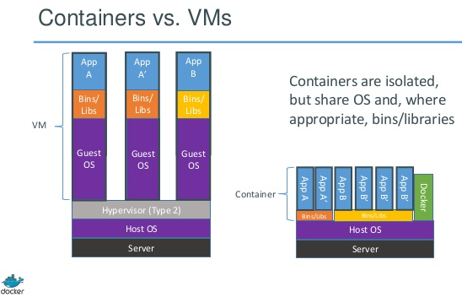
VM vs LXC

Slide 7
Docker Security Analysis
More Privileges = Insecure Environment .
So Security is major challenge in Docker.
Always compared with HV Based Virtualization it provides Sepaerate secure layer between host and application.
But Incase of CBV Process can directly communicate with host kernel which make easy for any attacker to attack on Host m/c
Which raises the very serious security issue.
So we need to ensure
Docker Container and Internal Sec
Security for the Kernel

Slide 8
Loopholes & Security Threats
Container every time need some extra privilege to Run
Required Root Privilege to run container on Docker Engine
Every Container creates FS on host m/c and allowed to change file on host based on its inode ,Which is not secure .
Which means process running as root (UID 0) inside container has root priveleges on underlying Host.
So if any malicious program running inside container may compromise whole system
This is very serious threat about containers based virtulazation

Slide 9
Fake System Calls .
Fake Image Pull & Container Run.
Remote Logging.
Leak to another container.
Easy Bypassing through Docker Engine.

Slide 10
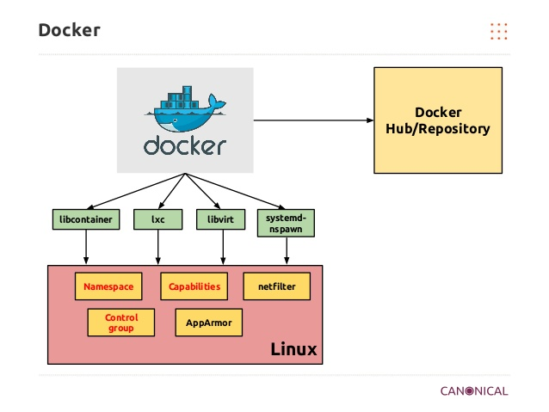
Existing Docker Security Systems & Models

Slide 11
How Namespaces ensure Security ?
Using 5 different namespaces to ensure security
a)PID
b)Mount
c)NET
d)IPC
e)UTS
a) PID – Process Isolation NS
Provide Process Isolation between running processes using PID
Provide a different view of file system.
Keeps comprised container away from other containers using process management interface.
Any process inside container can not observe or do with other process and hence ensures security.
Pid Ns allow any process to have init like pid(1 ) which terminates all other processes on its own termination.

Slide 12
b)File System Isolation( Mount NS )
Mount provides filesystem isolation.
Gives different filesystem view for each container
Using two file system mechanism it can remover write permission from compromised container and
Not allowing any process of container to remount FS .
c)Network Isolation(Net Namespaces)
Net NS provide independent n/w stack for every container.
N/w traffic of other container can’t be manipulate .
connections with other container and host are made by Virtual network bridge
Avoid attacks such as ARP spoofing and MitM.
Default Docker Comm model is prone to ARP spoofing as there is no Packet filtering .

Slide 13
IPC Namespaces:
It Allows creation of separate IPC Namasespace.
It provide perfect mechanism for two process to communicate .
But Process in one namespace can’t read or write IPC resources in other Namespaces.
Every container = Own IPC NS.
So They can’t interfere with each other.
UTS :
Unix timesharing Namespaces Keeps system up to date .
Returns current version of Linux kernel running and provide other details.

Slide 14
Cgroups:
Cgroups Provide Limits and control on resource usage by every container.
If in case container tries to acces some important device node,storage ,main memory or other h/w then Host is on high risk
Cgroup limits device nodes that container can access .
Limit the resources like memory, Devices and Fs.
Also prevent container process to create new device nodes.
a)Union File System
UFS operate by creating layers
UFS provides Basic Building Blocks for Container.
Docker Use many UFS such as AUFS-Memory Driver ,VFS and DevieMapper.
b)Container Format
By Default Docker Supports libcontainer to wrap up all components.

Slide 15
Linux Capabilities
Linux Capabilities are another security aspects which applied successfully on Docker Platform.
Achieve Security by categorizing process as Privileged and Unprivileged .
By Default Docker Disable many capabilities from Container in order to prevent damage to Host.
So removing some of the root capabilities from containers make Host secure and also does not affect usability and Functionality.
some Important Capabilities are follow

Slide 16
CAP_SETPCAP Modify process capabilities
CAP_SY S_MODULE - Insert/Remove kernel modules
CAP_SY S_RAWIO - Modify Kernel Memory
CAP_SY S_PACCT - Configure process accounting
CAP_SY S_NICE - Modify Priority of processes
CAP_SY S_RESOURCE - Override Resource Limits
CAP_SY S_TIME - Modify the system clock
CAP_SY S_TTY _CONFIG - Configure tty devices
CAP_AUDIT_WRITE - Write the audit log
CAP_AUDIT_CONTROL- Configure Audit Subsystem
CAP_MAC_OV ERRIDE - Ignore Kernel MAC Policy
CAP_MAC_ADMIN - Configure MAC Configuration
CAP_SY SLOG Modify - Kernel printk behavior
CAP_NET_ADMIN - Configure the network
CAP_SY S_ADMIN - Catch all

Slide 17
Other Security Models
There are many additional security models which are combination of linux
Namespaces
Cgroups
Capabilties &
Other
a)SELinux
b)AppArmor
c)SECComp
d)GRSec

Slide 18
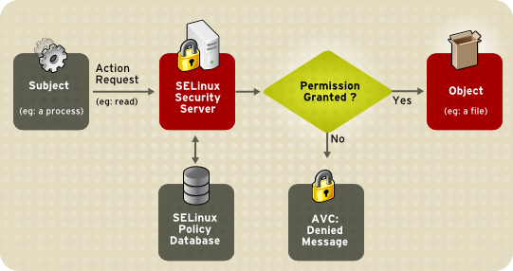
SELinux

Slide 19
SELinux is Security Enhanced Linux Archcitecture .
Based on DAC & MAC
DAC- Sets Owner/Group and Permission flags of object to control access to Objects.
MAC- Additional Permission checking layer
Every file, directory ,system object and process has lable
SYS Admin use Labels to write rules and policies to control access.
Kernel manages all access control over objects not Owner.
Type enforcement : Protect Host from process in container .
MCS: Protect Container from another container

Slide 20
AppArmor
Advance Security enhancement Model.
Used MAC but Different Mechanism.
Permit Admin to load Security Profile into Each Program.
Docker allow interface to load AppArmour profile while when launching a container.
Provide two models – Enforcement & Complain.
Enforcement – Enforce policy define in each profile.
Complain – It logs if there is in any violations of policies and Rules .
If Admin not include the sec profile then Docker Engine Automatocaly loads default profile which denies access to any file system on Host.

Slide 21
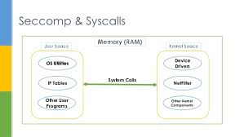
SECComp
SECComp Provides Systemcalls Filtering
You can block fake systemcalls using SECComp.
SECComp layer lies between Userpace & Kernel Space.

Slide 22
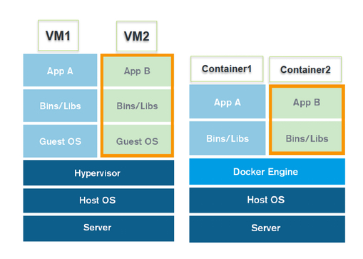
Proposed Security Models in Docker in Env
Model 1 : VM + LXC – Advance Sec layer between Host & App
Has to Bypass Guest kernel & Hyoervisor

Slide 23
Model 2:Root Remapping
UID: New Namespace
User Namespaces are used to provide User Isolation
What if ? Root Inside Container is not a Root Outside Container . This can be achieved using UID namspaces.
It is Docker Community’s own Idea & They encourage everyone to add own work to the idea.
It is good idea which can really makes Dockers more secure.
It will surely protect host from comprised container.

Slide 24
Model 3:Using own Access Control Mechanism
Currently Docker Security Uses DAC & MAC
No Security Docker Security Uses RBAC & ABAC
As They are not that Easy to apply on Docker Env.
RBAC:
Regulating access to computer or network resources based on the roles of individual users within an enterprise.
access is the ability of an individual user to perform a specific task, such as view, create, or modify a file.
ABAC:
Access rights are granted to user through polices which combine all attributes together. Attributes E.g User ,Resource & Enviornment Att.

Slide 25
My Proposed ABAC Layer On Docker:
Attributes
Action
.
Authorization Decision
User
Subject
Yes/No
Object
Context
Policy

Slide 26
Model 4:Hybrid Model
Network (Firewall ,IDS)
Host(Patch Management)
Application (WAF,SDLC)
Data (Access Control,DLP)

Slide 27
THANK YOU

